Slide 1

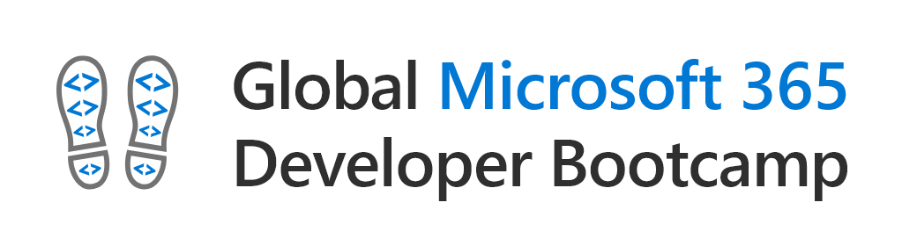
CONNECT SPFX WITH SECURED APIS
Giuseppe marchi – dev4side
www.peppedotnet.it - www.dev4side.com

Slide 2

Hello, i am peppe
Founder of Dev4Side S.r.l.
Microsoft MVP for 10 years in a row
Speaker on community of official Microsoft events in Italy
"SharePointer" from 2005
Father of www.peppedotnet.it ☺
Office 365 advisor for www.office365italia.com
Author of the book "Pocket C#“ - Apogeo
One of the SharePoint and Office 365 influencers (for 2014 e 2015)

Slide 3
Agenda
CALLING THIRD PARTY APIS
CALLING SHAREPOINT REST APIS
CALLING GRAPH APIS
CALLING ENTERPRISE APIS
ISOLETED WEB PARTS

Slide 4
demo
How to call third party apis (anonymous) and sharepoint rest apis

Slide 5
Calling graph apis
considerations

Slide 6
Calling GRAPH apis - Considerations
You will need to
have tenant
administration
permission to grant
access to Graph APIs
Granted
permissions for the
Graph API apply to all
customizations
running in the
tenant

Slide 7
Calling enterprise apis
considerations and architecture

Slide 8
Calling enterprise apis - Considerations
Even though API is
hosted in the same
Azure AD, there’s
no access to it by
default
You will need to
have tenant
administration
permission to grant
access to APIs
Granted
permissions for the
API apply to all
customizations
running in the
tenant
If you are hosting the API in a different Azure AD, you need admin consent (multi-tenant)

Slide 9
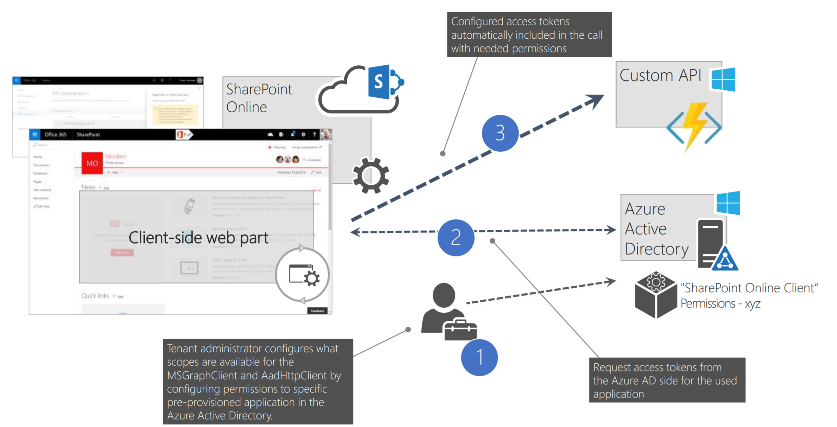
architecture

Slide 10
Calling enterprise apis – How to
Secure the API with a new Azure AD app registration
Enable CORS
Insert the needed permission inside package-solution.json
Build and deploy the solution in the app catalog
Approve the requested permissions from SharePoint Administration portal
… now you can start debugging!

Slide 11
demo
How to call enterprise apis

Slide 12
Isolated web parts
What are these?

Slide 13
Isoleted web parts
Even though API is
hosted in the same
Azure AD, there’s
no access to it by
default
You will need to
have tenant
administration
permission to grant
access to APIs
Granted
permissions for the
API apply to all
customizations
running in the
tenant
If you are hosting the API in a different Azure AD, you need admin consent (multi-tenant)

Slide 14
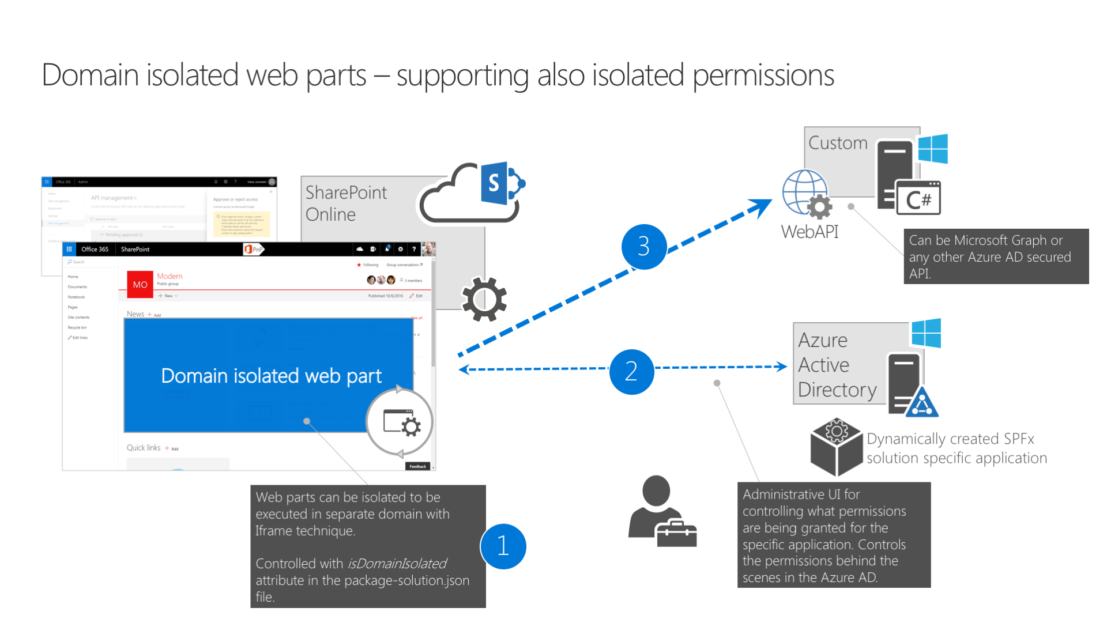
Isoleted web parts - Architecture

Slide 15
Isolated web parts
The choice to have an isolated web part can be done during new project generation or anytime modifying the property "isDomainIsolated" available inside package-solution.json file
So is the entire package that is "domain isolated" !
Isolated web parts run inside an iframe
Pay attention at UI and UX!
A specific App Registration is automatically created inside your Azure AD once permissions are approved
If you need to revert back an isolated web part, remember to first remove the package from the App Catalog

Slide 16

Sample code on Github
https://github.com/PeppeDotNet

Slide 17
THX ☺
Giuseppe marchi – dev4side

